Slide 1

Culinary Arts Academy: Transform Your Cooking Skills
Presented by: Usaid Shahid
Fatima Bhatti
Zainab Amir
Eman Sarfraz
Azkia Riaz
.

Slide 2

Project Overview & Objectives
Integrated Platform Development
Technical Proficiency & Real-World Application
To design and implement a comprehensive suite of academic deliverables, including a fully functional website, an Excel enrollment tracker, and a Word brochure, all centred around a culinary classes concept.
To demonstrate mastery of semantic HTML5 and CSS for web development, alongside practical data management in Excel, showcasing skills applicable to real-world deployment.
Engaging User Experience
To create an accessible, responsive, and visually professional digital platform that effectively promotes culinary education and fosters student engagement.

Slide 3
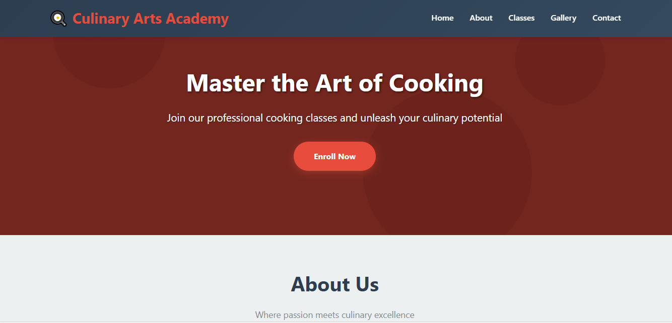
Website Demonstration: Home Page
Hero Section & Call-to-Action
The home page serves as a welcoming gateway, featuring a prominent hero section that immediately introduces the Culinary Arts Academy. A clear call-to-action guides visitors to explore course offerings.
Key Information
Institutional background and mission
Key statistics: 5,000+ students trained, 98%
satisfaction rate

Slide 4
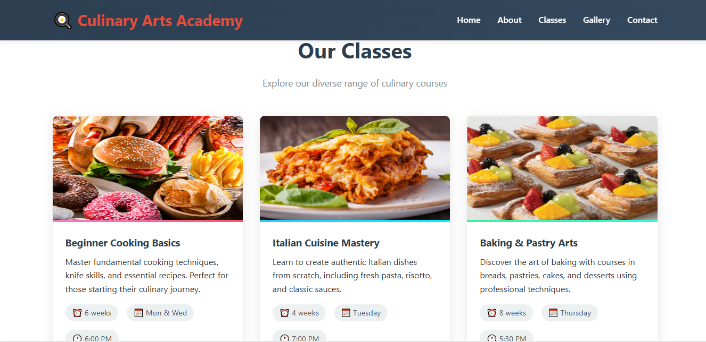
Website Demonstration: Classes Page
Detailed Course Offerings
This section provides prospective students with comprehensive information about each culinary class, enabling informed decisions.
Duration & Schedules
Pricing (e.g., Italian Cuisine Mastery: $249)
Variety of culinary specialities

Slide 5
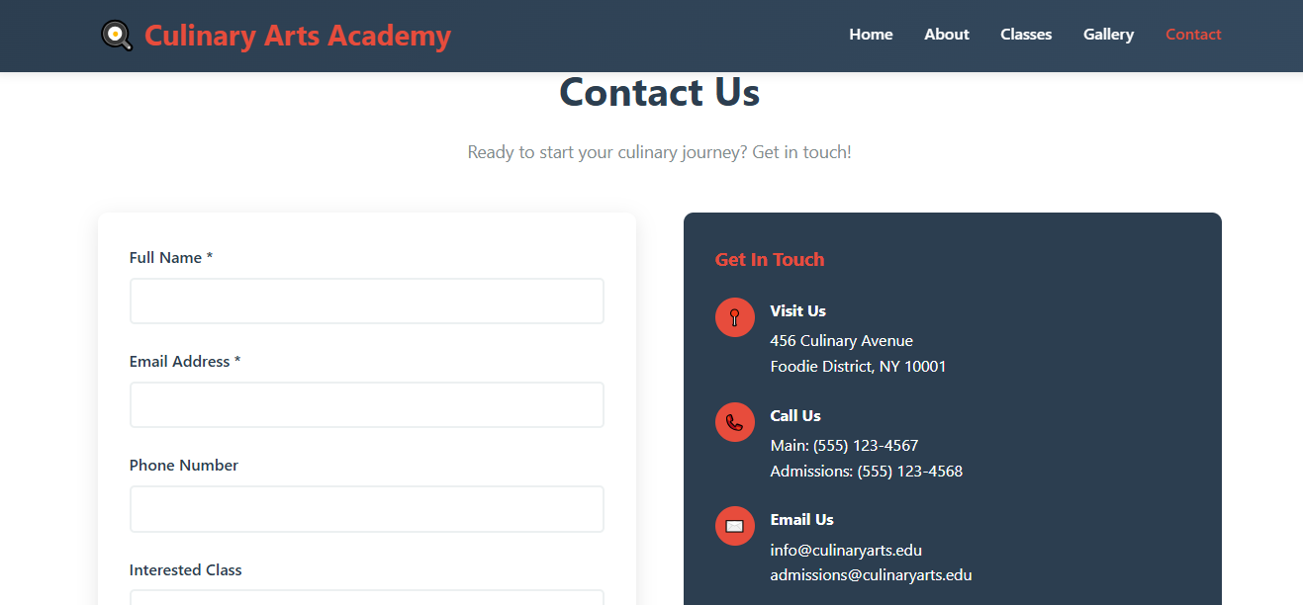
Website Demonstration: Contact Page
Structured Communication
The contact page facilitates easy communication, providing all necessary details for inquiries and engagement.
Physical address and contact numbers
Social media integration
HTML-only contact form for direct messages

Slide 6
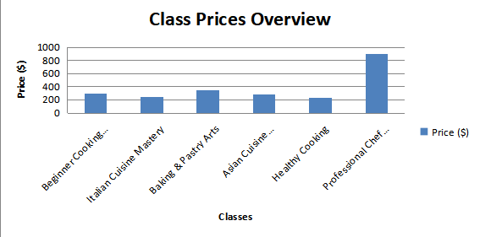
Enrollment Data & Fee Calculations
Leveraging Excel, we tracked enrolment figures and calculated fees across various classes. This visualisation illustrates the
popularity and revenue generation from our offerings.
The chart highlights the higher enrolment in foundational skills classes, suggesting a robust demand for introductory culinary
training.

Slide 7
Design Decisions & Rationale
Clean, Professional Aesthetic
1
A focus on readability and clear visual hierarchy ensures an intuitive user experience. Modern, web-safe sans-serif fonts enhance content legibility.
Responsive Layout
2
Utilising CSS Grid and Flexbox, the website dynamically adapts to various screen sizes, providing seamless usability across mobile and desktop devices.
Consistent Branding
3
Structured sections, consistent spacing, and clear call-to-action buttons maintain a cohesive brand identity throughout the site.
Semantic HTML5 for Accessibility
4
The use of semantic HTML5 not only improves search engine optimisation but also ensures greater accessibility for all users.

Slide 8

Accessing the Project
Live Website on GitHub Pages
GitHub Repository
Experience the Culinary Arts Academy website directly:
Explore the full codebase, including HTML, CSS, and project documentation:
https://yourusername.github.io/culinary-arts-academy
https://github.com/yourusername/culinary-arts-academy
To run the site locally, simply open the HTML file in any modern web browser. For publishing, upload HTML and CSS files to a static hosting service.

Slide 9

Reflection on the Project
Challenges & Learning Outcomes
This project provided invaluable experience in structuring semantic HTML5 documents and implementing responsive layouts using CSS Grid and Flexbox. Overcoming design challenges sharpened problem-solving skills.
Mastering responsive design techniques
Ensuring cross-browser compatibility
Balancing aesthetic appeal with functional requirements

Slide 10
Next Steps & Future Enhancements
Executive Summary
This project successfully delivered a robust culinary education platform, demonstrating proficiency in web development and data management, and exceeding academic assessment criteria.
Image Optimization & CDN
Implementing image optimisation techniques and integrating a Content Delivery Network (CDN) for faster load times.
Backend Form Handling
Developing server-side logic for the contact form to process submissions and enhance interactivity.
Accessibility & SEO Audits
Conducting comprehensive audits to ensure WCAG compliance and improved search engine visibility.
Multi-Page Navigation
Evolving from a single-page layout to a multi-page structure to support future content scalability.

